Slide 1
Azure Serverless Workshop
David COPPET
Azure App Consult

Slide 2
Agenda
Introduction to Serverless
Azure Functions overview
Module 1 – Serverless API
Cosmos DB overview
Module 2 – Adding Cosmos DB data
Event Grid overview
Module 3 – Making the solution event-driven
Logic Apps overview
Module 4 – Orchestrating serverless workflows

Slide 3
Serverless?

Slide 4
History of cloud development
Increasingly advanced cloud technologies have led companies to entrust more and more of their IT activities to service providers
On-premises
IaaS
PaaS
Serverless
Servers & storage
Security
OS & software
Dev tools
Apps & services

Slide 5


What is serverless?
Full abstraction of servers
Developers can just focus on their code—there are no distractions around server management, capacity planning, or availability.
Instant, event-driven scalability
Application components react to events and triggers in near real-time with virtually unlimited scalability; compute resources are used as needed.
Pay-per-use
Only pay for what you use: billing is typically calculated on the number of function calls, code execution time, and memory used.*
*Supporting services, like storage and networking, may be charged separately.

Slide 6

What are the benefits?
Solve business problems—not technology problems related to undifferentiated heavy lifting
Focus
Shorter time to market
Fixed costs converted to variable costs
Better service stability
Better development and testing management
Less waste
Efficiency
Simplified starting experience
Easier pivoting means more flexibility
Easier experimentation
Scale at your pace—don’t bet the farm on Day 1
Natural fit for microservices
Flexibility

Slide 7
What are we building today?

Slide 8
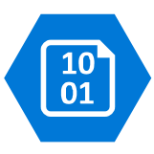






Best For You Organics Company (BFYOC)
Ice cream company on a cloud native journey
1
Serverless API
1
2
Distributed data
GET /products?id={id}
3
Event-driven communication
3
POST /addProducts
4
Serverless orchestration
4
B
CI/CD pipeline
POST /iceCreamOrder
2

Slide 9
Pre-requisites
Azure subscription
Visual Studio or Visual Studio Code
.NET Core 2.1 SDK
NodeJS 8 (LTS) or 10 (Current)
Azure Functions Core Tools v2
HTTP tester like Postman (recommended)
Find all the content at
https://aka.ms/aac-serverless-workshop

Slide 10
Build apps faster with Azure Functions

Slide 11
FaaS is at the center of serverless Functions-as-a-Service programming model use functions to achieve true serverless compute
Single responsibility
Functions are single-purposed, reusable pieces of code that process an input and return a result
Short lived
Functions don’t stick around when finished executing, freeing up resources for further executions
Stateless
Functions don’t hold any persistent state and don’t rely on the state of any other processes
Event driven & scalable
Functions respond to predefined events, and are instantly replicated as many times as needed

Slide 12

What is Azure Functions? An event-based, serverless compute experience that accelerates app development
Azure Functions = FaaS++
Integrated programming model
Use built-in triggers and bindings to define when a function is invoked and to what data it connects
Enhanced development experience
Code, test and debug locally using your preferred editor or the easy-to-use web based interface including monitoring
Hosting options flexibility
Choose the deployment model that better fits your business needs without compromising development experience

Slide 13


Introducing Functions
Code
Azure Functions
Events + data

Slide 14

Focus on code, not plumbing
No infrastructure management
Auto-scale based on your workload
No wasted resources, pay only for what you use

Slide 15
Logic – not plumbing
Bindings
Inputs
Bindings
CODE
Outputs
Trigger

Slide 16


Boost development efficiency
Trigger object
Your code
Input object
Input Binding
Output object
Trigger
Output Binding

Slide 17
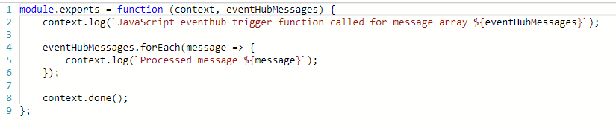
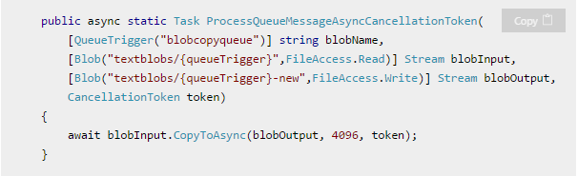
What is the “Functions” programming model?
Function as the unit of work
Functions are executed; they start and finish
Functions have triggers
Functions can have inputs and outputs (bindings)
Notes:
First, a simple event hub JS function (just trigger)
Then, a good example of a C# function with a trigger and input/output bindings

Slide 18
Language Support
Editor | Recommended for* | Features | Platform
Azure Portal | Trying it out, simple scripts (C# / JavaScript) | Browser-based; host compiler; automatic dependencies mgmt | Any
Visual Studio | C# / F# (class library) | Visual Studio build / debug / publish; cloud explorer; rich project types | Windows
Visual Studio Code | JavaScript, Java, Python* | Lightweight; tons of extensions; local debugging | Any
IntelliJ / Eclipse | Java (via Maven) | Refactoring; Smart Completion; Maven integration | Any
Note taking file editor + Functions Core Tools |  | Minimalism; traditional-style | Any
*Additional Experimental Languages: Python, Bash, Powershell, Batch, PHP, TypeScript
Notes:
Per previous slide, you can write Functions in many languages, with more on the way!
All experimental means is that its meant for POCs rather than production workloads in its current state.

Slide 19


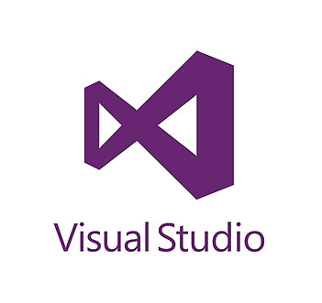
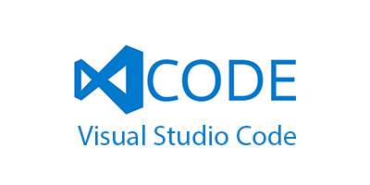
Azure Functions Tooling Options
Portal
Visual Studio
VS Code
CLI
Maven (Java)

Slide 20
Key Indicators for Serverless

Slide 21
Key Indicators for Serverless
Stateless and scale
Not worth deploying a traditional backend
Workload is sporadic (high volatility of demand)
Dev ops favored versus dedicated ops
Lots of different services that need “glue”

Slide 22
Serverless scenarios: anything that responds to events
Timer-based processing
Real-time stream processing
Every 15 minutes
Find and clean invalid data
Clean table
Millions of devices feed into Stream Analytics
Transform to structured data
Store data in SQL DB
Mobile app backends
Real-time bot messaging
?
...
Photo taken and WebHook called
Stores in blob storage
Produces scaled images
Message sent to Chatbot
Chatbot sends
response
Cortana Analytics answers questions

Slide 23
Patterns to Follow
Keep execution short and return quickly
Decouple tasks
Do as little work synchronously as possible
Trigger in batches – and catch exceptions
Global static variables for things like HttpClient
Always use App Insights (now on by default)
Use a DevOps pipeline such as VSTS
Compile and or pack to optimize cold start times
Notes:
Similar to microservice patterns (12 factor)

Slide 24
New Visual Studio 2017 tooling
Based on class libraries
Get the full power of IntelliSense, unit testing, and local debugging
Use WebJobs attributes to define triggers and bindings
Learn more at https://aka.ms/2017functiontools

Slide 25
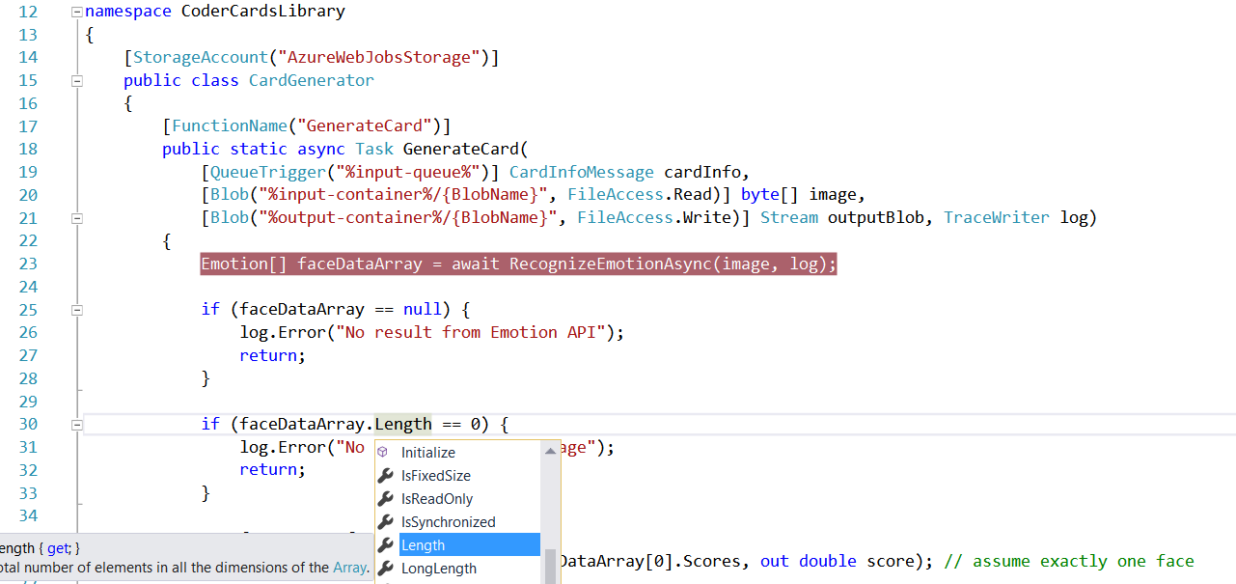
Visual Studio 2017 Tooling

Slide 26
Advanced stuff
Functions CLI and debugging

Slide 27
Platform and scaling
App Service offers dedicated and dynamic tiers.
Dedicated is the existing App Service plan tiers
Basic, Standard, Premium
Pay based on # of reserved VMs
You’re responsible for scale
Dynamic
Pay on number of executions
Platform responsible for scale

Slide 28
Dynamic tier pricing
Pay per execution model - two meters, three units
Number of executions
Duration of execution x reserved memory
First million executions free.

Slide 29
Durable Functions
Azure Functions extension
Enables long-running, stateful serverless operations
Write complex function orchestrations in a single function
Built on the open-source Durable Task Framework
Only pay when your code is running
Orchestrator replays itself to re-establish state every run

Slide 30
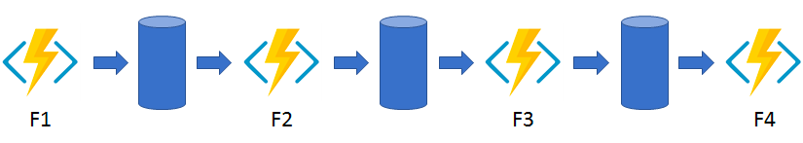
Durable functions - Patterns
Functions chaining
Async HTTP APIs
Fan out / Fan in
Human interaction

Slide 31




What’s new in Azure Functions
Trigger a function based on changes in Cosmos DB
Database
Local Development
Develop functions locally on Linux, MacOS, Windows
Functions
Durable Functions
Long running, stateful functions
Securely provide access to information in Microsoft Graph through a function
Security
Execute your code based on events you specify
Monitoring
Monitor serverless applications using Application Insights
Trigger a function from a real-time analytics pipeline in Stream Analytics
Analytics

Slide 32

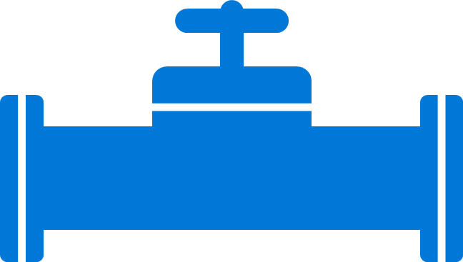
Boost development efficiency
Use triggers to define how functions are invoked
Avoid hardcoding with preconfigured JSON files
Build serverless APIs using HTTP triggers
Connect to data with input and output bindings
Bind to Azure solutions and third-party services
Use HTTP bindings in tandem with HTTP triggers
Triggers
Bindings
Define one API surface for multiple function apps
Create endpoints as reverse proxies to other APIs
Condition proxies to use variables
Debug C# and JavaScript functions locally
Use debugging tools in Azure portal, VS, and VS Code
Proxies
Local debugging
Save time with built-in DevOps
Deploy functions using App Service for CI
Leverage Microsoft, partner services for CD
Integrate with Azure Application Insights
Get near real-time details about function apps
See metrics around failures, executions, etc.
CI/CD
Monitoring

Slide 33


Gain flexibility and develop your way
Write code in C#, JavaScript, F#, and Java
Continuous investment in new, experimental languages
Write stateful functions in a serverless environment
Simplify complex, stateful coordination problems
Add the extension to enable advanced scenarios
Multiple languages
Durable Functions
Choose from six consumption plans to run Functions
Run your first million function executions for free
Simplify coding for new users with native Azure portal
Select from popular editors, like VS, VS Code, CLI, Maven*
Hosting options
Dev options
*VS and VS Code only support C#; Maven only supports Java

Slide 34





Gain flexibility and develop your way
Consumption
AS Plan
AS Environment
Azure Stack
Runtime
IoT Edge
Serverless
Free, Basic, Standard, Premium
Network isolation
On-premises
Functions on your server
On devices
Only pay for what you use; charges apply per execution and per GB second
Gain all the advantages of Functions along with Microsoft’s financially-backed SLA and the always-on features of an App Service Plan
Use a dedicated App Service cloud environment (ASE) that comes with network isolation for apps, greater scale, and secure connectivity to local vNets
Bring the power of the entire Azure stack to your own data centers
Run Functions on your local server; does not include the entire Azure stack
Deploy custom Azure modules on IoT devices
Hosting options

Slide 35

Azure Functions is an open-source project Functions runtime and all extensions are fully open source
https://github.com/Azure/Azure-Functions

Slide 36






Full integration with Azure ecosystem Functions is the center piece of the Serverless platform
Development
Platform
IDE support
Event Grid
Functions
Logic Apps
Manage all events that can trigger code or logic
Execute your code based on events you specify
Design workflows and orchestrate processes
Integrated DevOps
Local development
Monitoring
Database
Storage
Analytics
Intelligence
Security
IoT
Visual debug history

Slide 37
Module 1 – Serverless API
Instructions at
https://aka.ms/aac-serverless-workshop

Slide 38

Sample scenarios
Web application backends
Mobile application backends
IoT-connected backends
Conversational bot processing
Real-time file processing
Real-time stream processing
Automation of scheduled tasks
Extending SaaS Applications

Slide 39



Web application backends
Scenario Example
Retail
Online orders are picked up from a queue, processed and the resulting data is stored in a database.
Request made in a web app
Request queued in Service Bus
A function processes the request…
…sends output to Cosmos DB

Slide 40


Mobile application backends
Scenario Example
Financial Services
Colleagues use mobile banking to reimburse each other for lunch: the person who paid for lunch requests payment through his mobile app, triggering a notification on his colleagues’ phones.
HTTP API call from a mobile app
Call processed by a function
Output data stored in Cosmos DB
Data transfer triggers second function…
…which sends notifications using Notifications Hub

Slide 41





IoT-connected backends
Connected IoT devices producing data
Scenario Example
Manufacturing
Data sent to IoT Hub
A manufacturing company uses IoT to monitor its machines. Functions detects anomalous data and triggers a message to Service department when repair is required.
Data with special condition routed to a function
A function processes message...
…and calls Logic Apps
…which invokes Zendesk…
…to request device repair

Slide 42

Conversational bot processing
Scenario Example
Hospitality
Customer asks for available vacation accommodations on her smartphone. A serverless bot deciphers the request and returns vacation options.
?
?
?
User request through conversational interface
Bot running in a function deciphers request using language understanding
Another function processes the request
…and sends response to original requester

Slide 43






Real-time file processing
Scenario Example
Healthcare
Patient records are securely uploaded as PDF files. That data is then decomposed, processed using OCR detection, and added to a database for easy queries.
PDF file added to Blob Storage
A function decomposes PDF file…
…and sends it to Cognitive Services for OCR detection
Structured data from file sent to SQL DB

Slide 44


Real-time stream processing
App or device producing data
Scenario Example
ISV
Huge amounts of telemetry data is collected from a massive cloud app. That data is processed in near real-time and stored in a DB for use in an analytics dashboard.
Event Hubs ingests telemetry data
A function processes the data…
…and sends it to Cosmos DB
Data used for dashboard visualizations

Slide 45

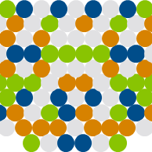
Automation of scheduled tasks
Scenario Example
Financial Services
A customer database is analyzed for duplicate entries every 15 minutes, to avoid multiple communications being sent out to same customers.
A function cleans a database every 15 minutes…
…deduplicating entries based on business logic

Slide 46




Extending SaaS applications
Scenario Example
Professional Services
A SaaS solution provides extensibility through webhooks, which can be implemented through Functions, to automate certain workflows.
Issue created in GitHub…
…which triggers a webhook call
…which is processed by a function…
…by posting the issue details to Slack

Slide 47


What makes Functions unique?
Feature variety
Flexible run options
A host of features, from bindings to code editors, gives you the tools needed to quickly create the best apps
Durable Functions
With so many plan options, you can choose the level of access that’s best for your company and customers
With this extension Azure Functions help you simplify complex, stateful orchestration problems
Intuitive experience
Consolidated tools
Easy-to-use, familiar tools like the Azure portal and Visual Studio help you get running on serverless fast
Thanks to so many built-in solutions, you can do more in Functions than AWS, which often requires external tools

Slide 48
Cosmos DB

Slide 49
Modern apps face new challenges
Managing and syncing data distributed around the globe
Delivering highly-responsive, real-time personalization
Processing and analyzing large, complex data
Scaling both throughput and storage based on global demand
Offering low-latency to global users
Modernizing existing apps and data –
Personalization, Recommendation, Social, Gamification.

Slide 50
Azure Cosmos db
A FULLY-MANAGED MULTI MODEL, MULTI MASTER, GLOBALLY DISTRIBUTED DATABASE SERVICE BUILT TO GUARANTEE
EXTREMELY LOW LATENCY AND MASSIVE SCALE FOR MODERN APPS

Slide 51



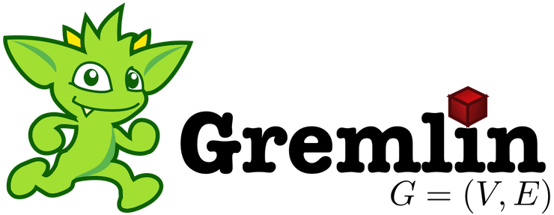

SQL
mongoDB
Azure Cosmos DB
… more coming soon
Key-Value
Column-family
Documents
Graph
Global distribution
Elastic scale out
Guaranteed low latency
Five consistency models
Comprehensive SLAs
A globally-distributed, multi-model, database service

Slide 52
Turnkey global distribution
PUT YOUR DATA WHERE YOUR USERS ARE IN MINUTES
Automatically replicate all your data around the world, and across more regions than Amazon and Google combined.
Available in all Azure regions
Manual and automatic failover
Automatic & synchronous multi-region replication

Slide 53
ELASTIC SCALE OUT OF STORAGE AND THROUGHPUT
SCALES AS YOUR APPS’ NEEDS CHANGE
Independently and elastically scale storage and throughput across regions – even during unpredictable traffic bursts – with a database that adapts to your app’s needs.
Elastically scale throughput from 10 to 100s of millions of requests/sec across multiple regions
Support for requests/sec for different workloads
Pay only for the throughput and storage you need

Slide 54
GUARANTEED LOW LATENCY
PROVIDE USERS AROUND THE WORLD WITH FAST ACCESS TO DATA
Serve <10 ms read and <15 ms write requests at the 99th percentile from the region nearest to users, while delivering data globally.

Slide 55
FIVE WELL-DEFINED CONSISTENCY MODELS
CHOOSE THE BEST CONSISTENCY MODEL FOR YOUR APP
Offers five consistency models
Provides control over performance-consistency tradeoffs, backed by comprehensive SLAs.
An intuitive programming model offering low latency and high availability for your planet-scale app.
Strong
Bounded-stateless
Session
Consistent prefix
Eventual

Slide 56



Multiple data models and apis
USE THE MODEL THAT FITS YOUR REQUIREMENTS, AND THE APIS, TOOLS, AND FRAMEWORKS YOU PREFER
Cosmos DB offers a multitude of APIs to access and query data including, SQL, various popular OSS APIs, and native support for NoSQL workloads.
Use key-value, tabular, graph, and document data
Data is automatically indexed, with no schema or secondary indexes required
Blazing fast queries with no lag
Table API
MongoDB
SQL
Column-family
Document
Key-value
Graph

Slide 57
COMPREHENSIVE SLAs
RUN YOUR APP ON WORLD-CLASS INFRASTRUCTURE
Azure Cosmos DB is the only service with financially-backed SLAs for millisecond latency at the 99th percentile, 99.999% HA and guaranteed throughput and consistency
Latency
HA
Throughput
Consistency
<10 ms
99.999%
Guaranteed
Guaranteed
99th percentile

Slide 58
Trust your data to industry-leading Security & Compliance
Azure is the world’s most trusted cloud, with more certifications than any other cloud provider.
Enterprise grade security
Encryption at Rest
Encryption is enabled automatically by default
Comprehensive Azure compliance certification

Slide 59
Top 10 reasons why customers use Azure Cosmos DB
The 1st and only database with global distribution turnkey capability
Deliver massive storage/throughput scalability database
Provides guaranteed single digit millisecond latency at 99th percentile worldwide
Natively supports different types of data at massive scale
Boasts 5 well-defined consistency models to pick the right consistency/latency/ throughput tradeoff
Enables mission critical intelligent applications
Gives high flexibility to optimize for speed and cost
Tackles big data workloads with high availability and reliability
Provides multi-tenancy and enterprise-grade security
Naturally analytics-ready and perfect for event-driven architectures

Slide 60



















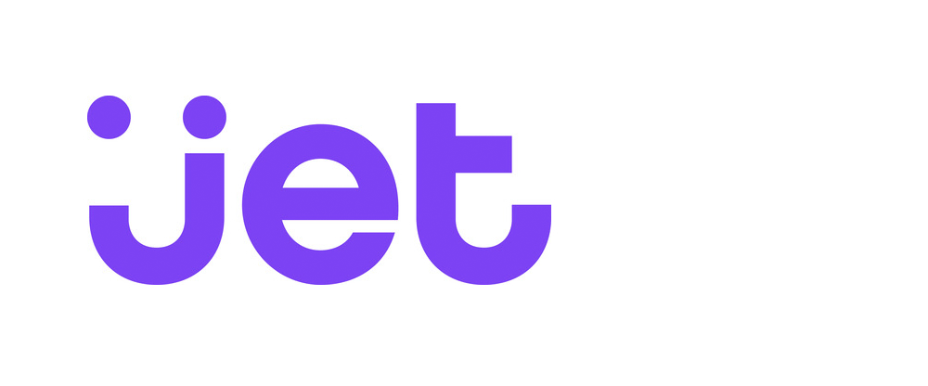





























Customers powering their Apps with Azure Cosmos DB
7000+ Azure Cosmos DB customers
NoSQL is growing at 35.1% YoY
20% of customers have migrated Apps from Mongo DB to Cosmos DB

Slide 61

Cosmos DB wins 2018 Technology of the Year Awards
“Do you need a distributed NoSQL database with a choice of APIs and consistency models? That would be Microsoft’s Azure Cosmos DB.”—InfoWorld, Technology of the Year 2018: The best hardware, software, and cloud services

Slide 62
Q & A

Slide 63
Change Feed

Slide 64
Change Feed
Persistent log of records within an Azure Cosmos DB container.
Documents presented in the order in which they were modified
New Events
Azure Cosmos DB
Change feed

Slide 65


Change Feed Scenarios
Event Computing and Notifications
Retail, Gaming, Content management
Trigger a call to an API when a document is inserted or modified
Azure functions
Azure Notification Hubs
Azure App Service
Stream Processing
IoT Processing, Data Science & Analytics
Perform real-time (stream) processing on updates to data
New Events
Azure Stream Analytics
Azure HDInsight
Apache Spark
Apache Storm
Azure Cosmos DB
Change feed
Data movement
Enterprise Data Management
Move, clone, or archive data to cold storage
Azure Storage Blob
Azure Data Lake
Azure Cosmos DB

Slide 66
Event Sourcing for Microservices
Trigger Action From Change Feed
Persistent Event Store
Microservice #1
New Event
Microservice #2
…
Azure Cosmos DB
Change feed
Microservice #N

Slide 67
Materializing Views
Application
Azure Cosmos DB
Materialized View
Subscription | User | Create Date | …
123abc | Ben6 | 6/17/17
456efg | Ben6 | 3/14/17
789hij | Jen4 | 8/1/16
012klm | Joe3 | 3/4/17
User | Total Subscriptions
Ben6 | 2
Jen4 | 1
Joe3 | 1
Change feed

Slide 68
Replicating Data
Secondary Datastore (e.g. archive)
Replicated Records
CRUD Data
Azure Cosmos DB
Change feed

Slide 69
Q & A

Slide 70
Module 2 – Adding Cosmos DB data
Instructions at
https://aka.ms/aac-serverless-workshop

Slide 71
Event based computing in Azure with Event Grid

Slide 72


Slide 74














Eventing in the cloud
Events
Event Handlers
Blob Storage
Serverless Code
Resource Groups
Functions
Azure Subscriptions
Event Grid
Serverless Workflow and Integration
Event Hubs
CloudEvents Format
Logic Apps
Azure Media Service
Buffering and
Competing Consumers
IoT Hub
Service Bus
Event Hubs
Storage
Queues
Custom Events (anything)
Other Services and Applications
CloudEvents Sources
Hybrid Connections
(WebSockets)
WebHooks (anything)
Azure Automation

Slide 75
Azure Event Grid
Fully-managed event routing
Near real-time event delivery at scale
Broad coverage within Azure and beyond
Backbone of event-driven computing

Slide 76
Benefits
Focus on innovation and pay per event
Ensure reliability and performance for your apps
Unlock new scenarios for your apps
Manage all events in one place

Slide 77
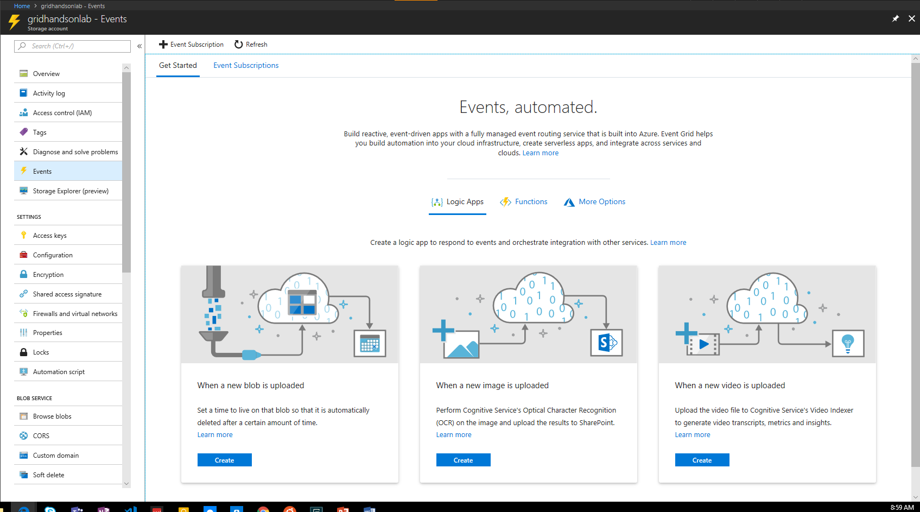
Manage all events in one place

Slide 78




Build applications efficiently
Management SDKs
Publish SDKs
Event Schema Store
Consumption SDKs
.Net Python Java Node.js Ruby Go

Slide 79
Ensure reliability and performance in your apps
SLA backed 99.99% availability
10,000,000 events per second per region
24-hour retry with exponential back off for events not delivered
High availability
Massive scale-out
High reliability

Slide 80
Benefit from broad coverage
Publishers
Subscribers
Coming Soon
Immediately available
Immediately available
Publishers
Azure Active Directory, API Management, Service Bus, Azure Data Lake Store, Cosmos DB, Azure Container Registry, Azure Security Center, Azure Media Services, KeyVault, Azure Container Instances, Azure Batch, Analytics
Blob Storage
Azure Functions
Resource Groups
Logic Apps
Azure Subscriptions
Azure Automation
Event Hubs
WebHooks
Subscribers
Service Bus, Azure Data Factory, Storage Queues, Azure Container Instances
Custom Events
Event Hubs
IoT Hub
General Purpose Storage v2
Service Bus

Slide 81
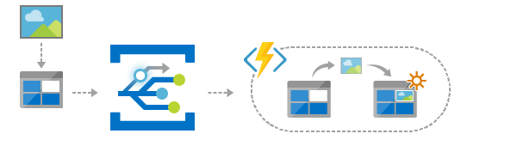
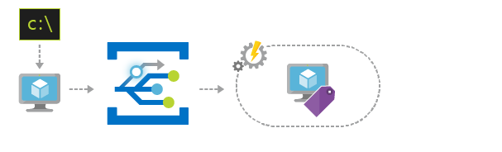
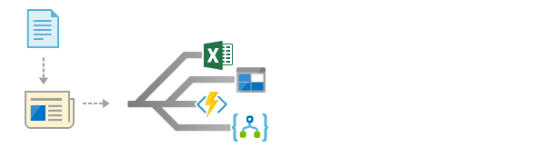
Scenarios
Serverless apps
Ops automation
Application integration
Instantly trigger a serverless function to run analysis when a new file is added to a blob storage container.
Speed up automation and simplify policy enforcement by notifying Azure Automation when underlying infrastructure is provisioned
Connects your app with other services. Create an application topic to route your app’s event data to any desired destination

Slide 82
Sample Event
[{
"topic": "/subscriptions/{subscription-id}/resourceGroups/Storage/providers/Microsoft.Storage/storageAccounts/xstoretestaccount“,
"subject": "/blobServices/default/containers/testcontainer/blobs/testfile.txt",
"eventType": "Microsoft.Storage.BlobCreated",
"eventTime": "2017-06-26T18:41:00.9584103Z",
"id": "831e1650-001e-001b-66ab-eeb76e069631",
"data": {
"api": "PutBlockList",
"clientRequestId": "6d79dbfb-0e37-4fc4-981f-442c9ca65760",
"requestId": "831e1650-001e-001b-66ab-eeb76e000000",
"eTag": "0x8D4BCC2E4835CD0",
"contentType": "text/plain",
"contentLength": 524288,
"blobType": "BlockBlob",
"url": "https://example.blob.core.windows.net/testcontainer/testfile.txt",
"sequencer": "00000000000004420000000000028963",
"storageDiagnostics": {
"batchId": "b68529f3-68cd-4744-baa4-3c0498ec19f0"
}
},
"dataVersion": "",
"metadataVersion": "1“
}]

Slide 83

Learn more at azure.com/EventGrid

Slide 84
Module 3 – Making the solution event-driven
Instructions at
https://aka.ms/aac-serverless-workshop

Slide 85
Integration Made Easy with Logic Apps

Slide 86
The Internet
noun | ˈt͟hē in-ter-net
A technological universe made up by millions of different services, interconnected via APIs, that all look a little bit different from one to the other, and takes hours if not days to integrate with.

Slide 87
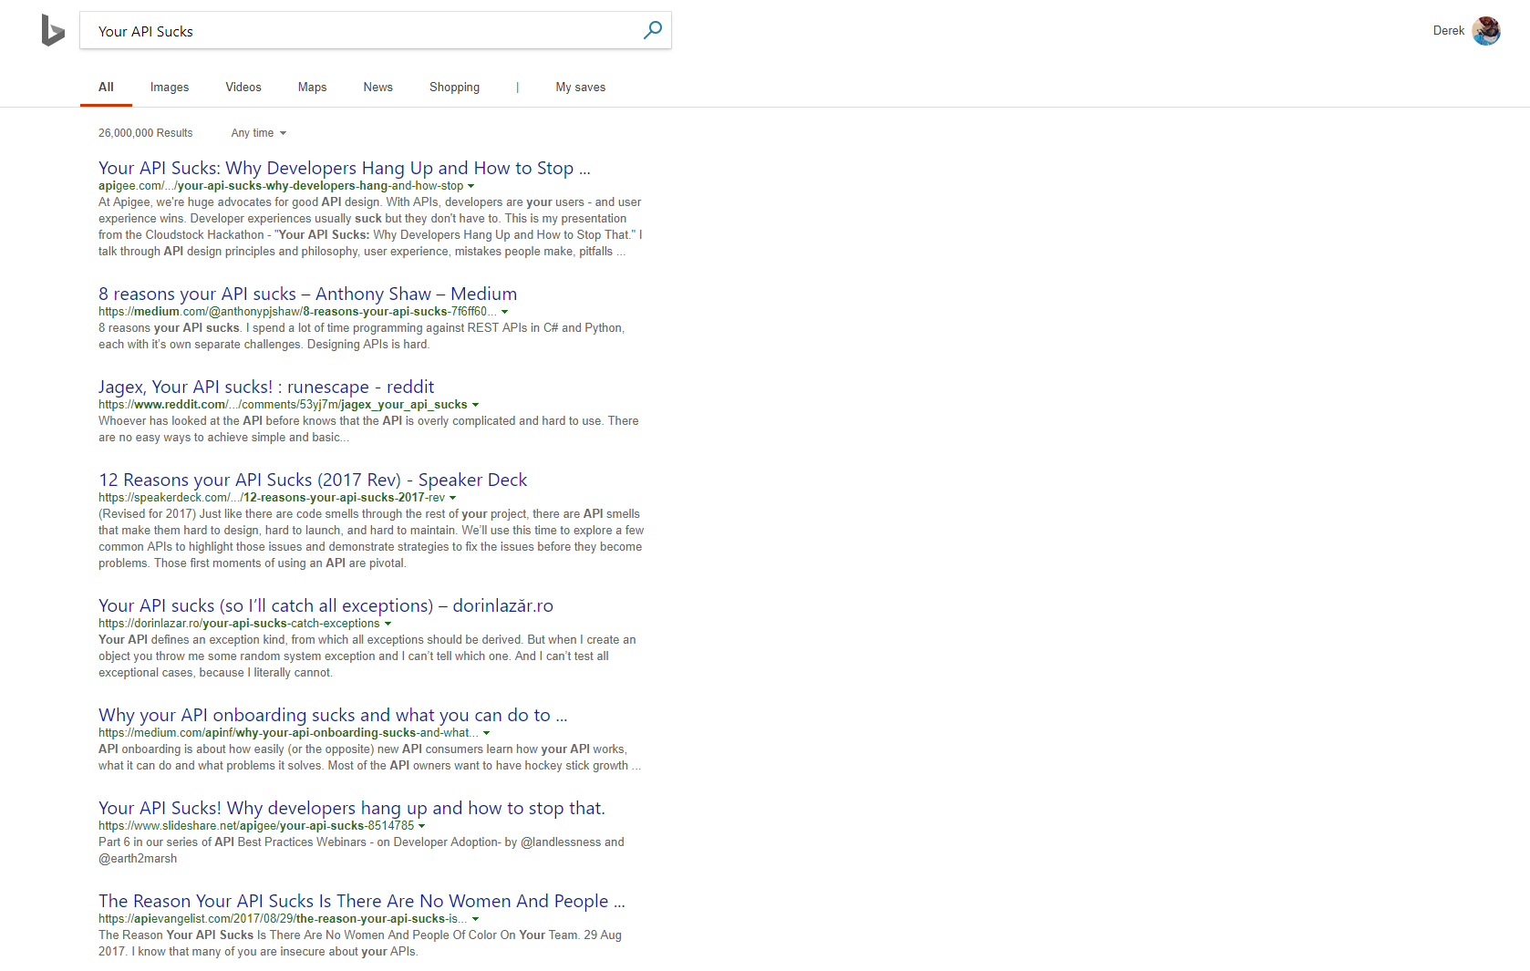

Slide 88




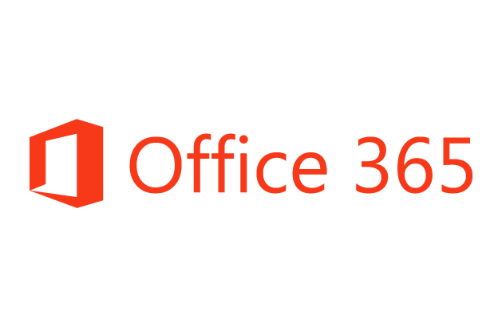


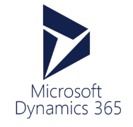










Azure Functions
Service Bus
Cognitive Services
Logic Apps
Machine Learning
Azure API Management
On-premises data gateway
BizTalk Server

Slide 89
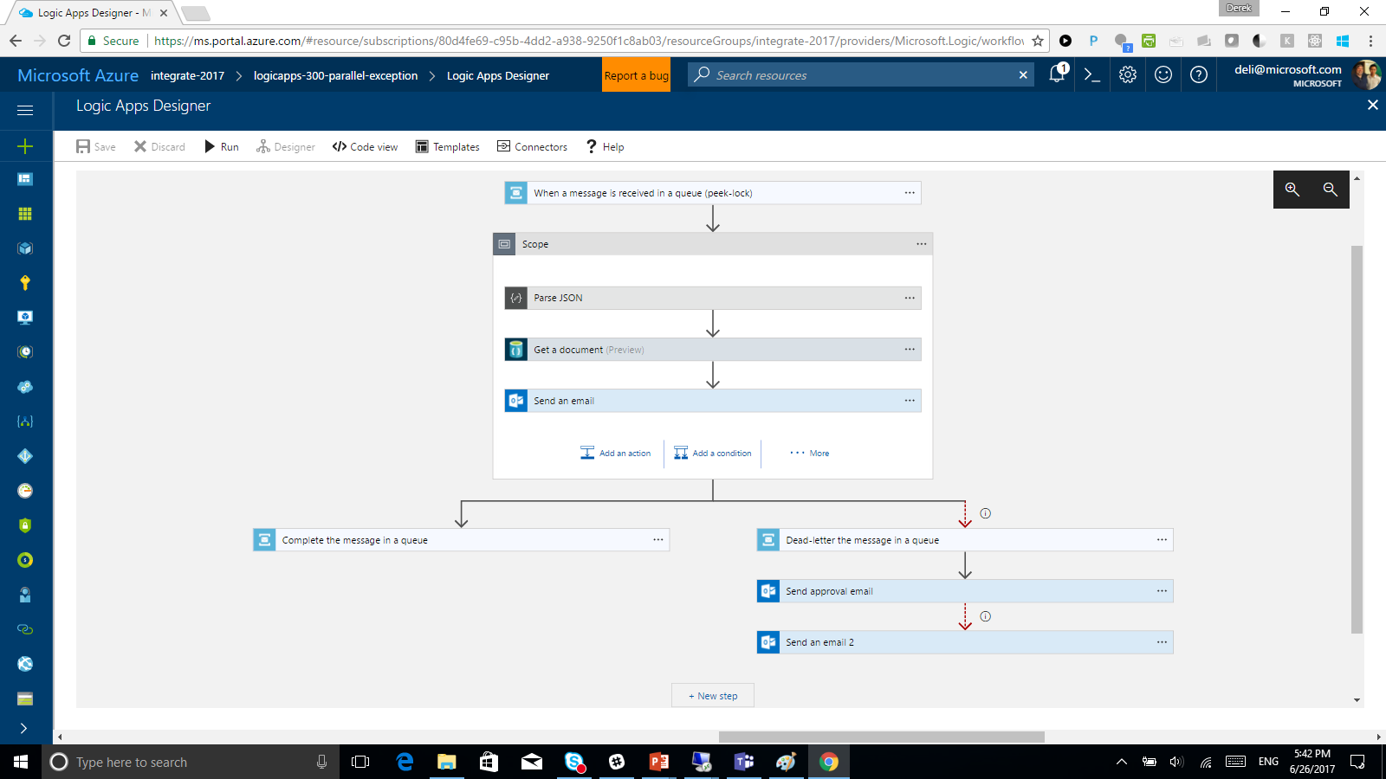

Slide 90
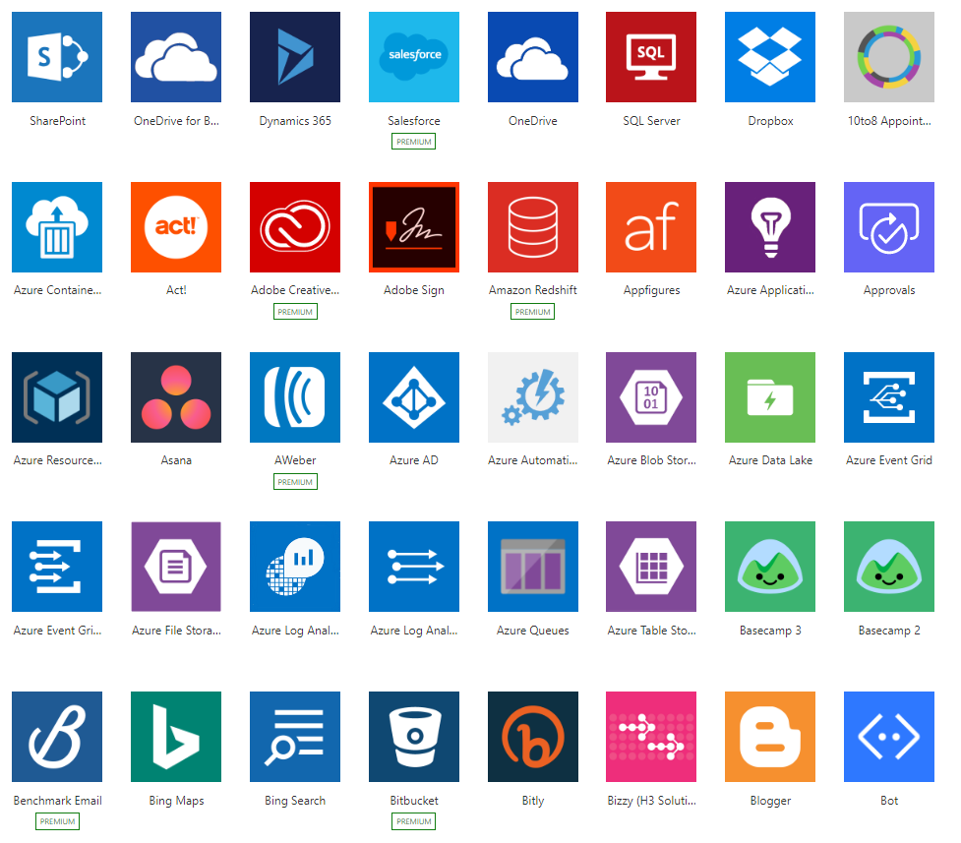
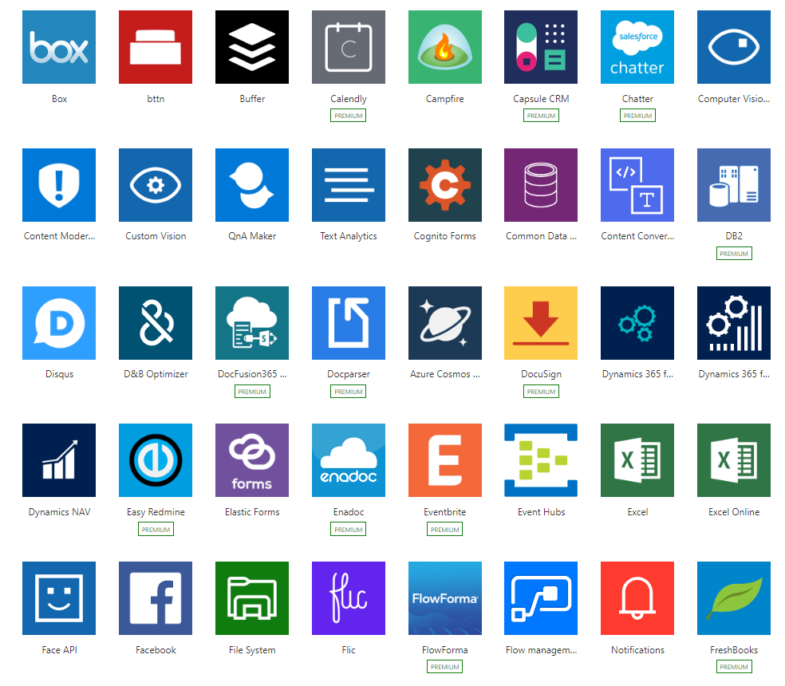
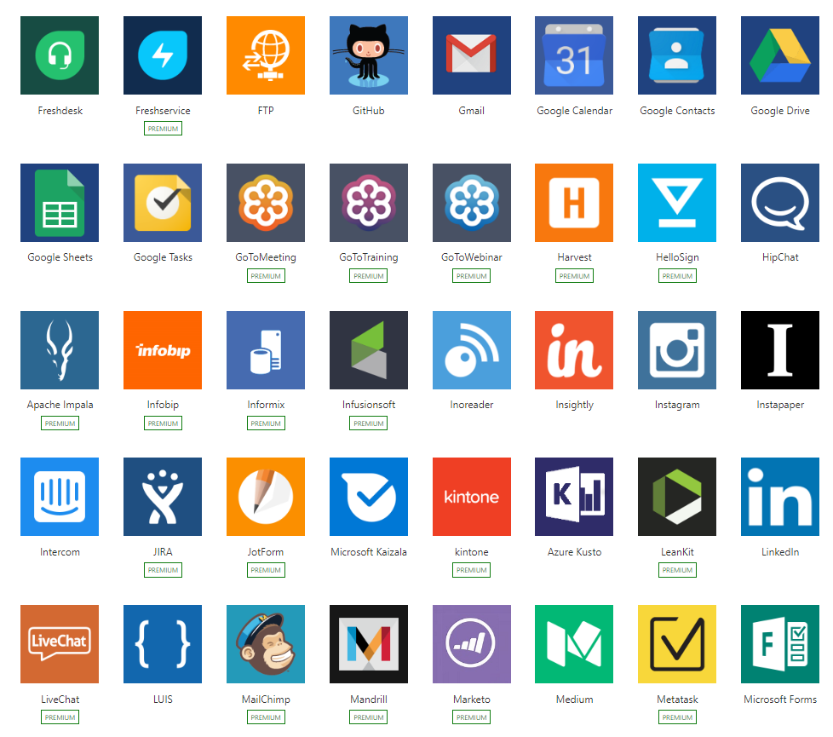
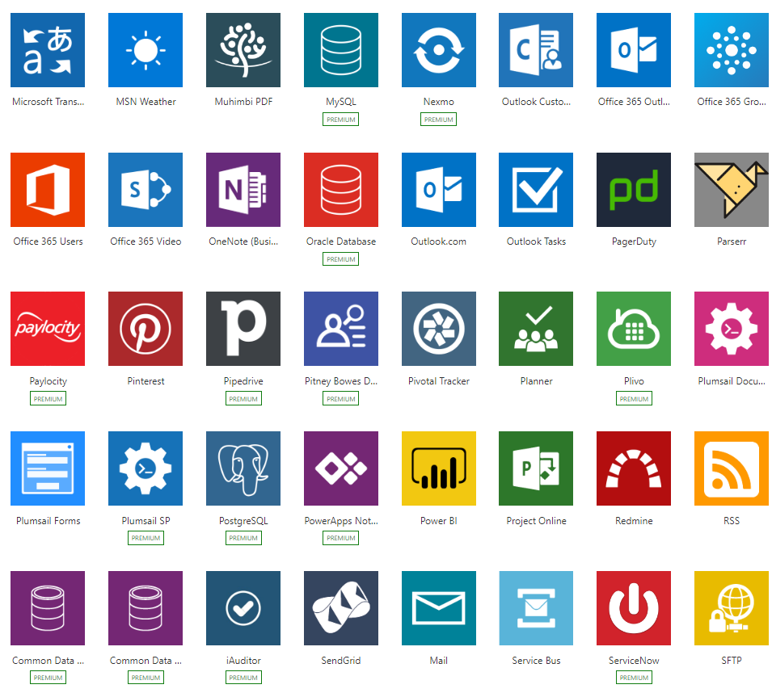
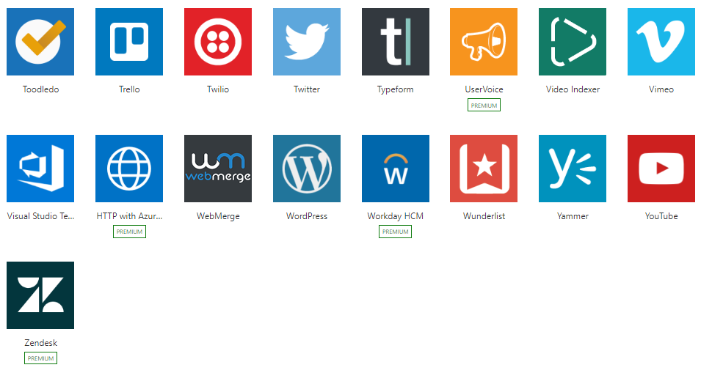
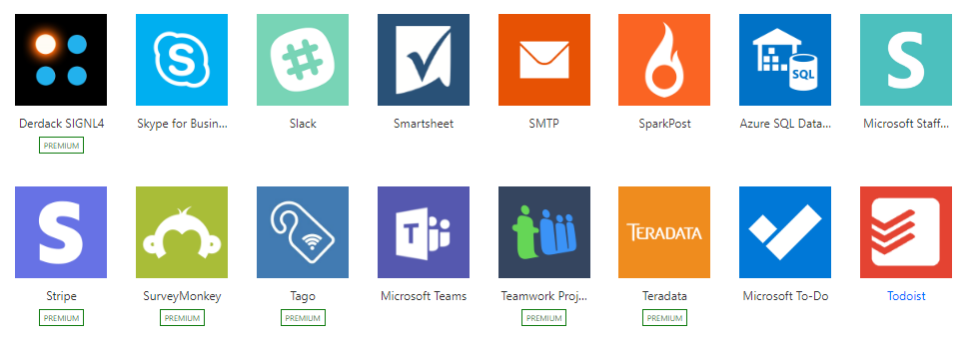
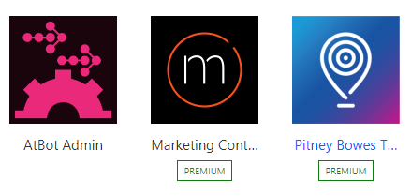
Connected
Built-in connectivity to 200+ SaaS cloud services, file providers, databases, web APIs, productivity apps, and more
Connect to on-premises systems via Data Gateway
Pluggable extensibility via Custom Connectors to integrate existing LOB systems into Logic Apps including SOAP support

Slide 91
$0.000025 ~ $0.000125 / action*
cost varies by region

Slide 92
Hello World to Integration Hero in 5 Minutes
Demo

Slide 93
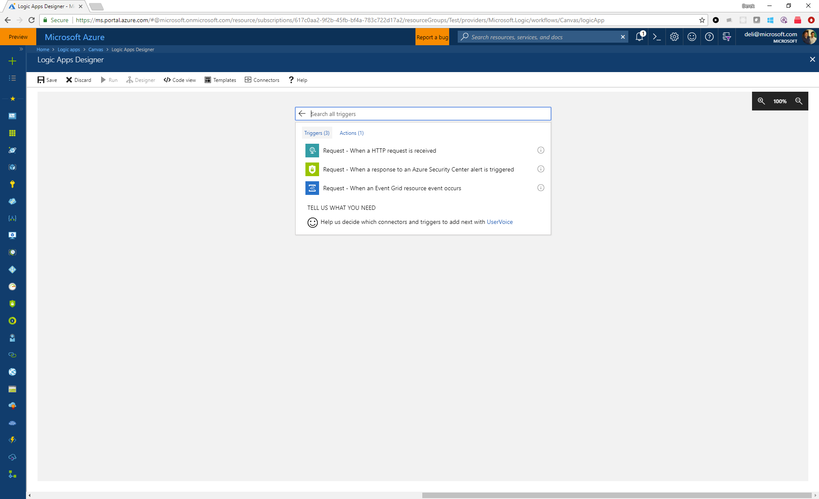

Slide 94
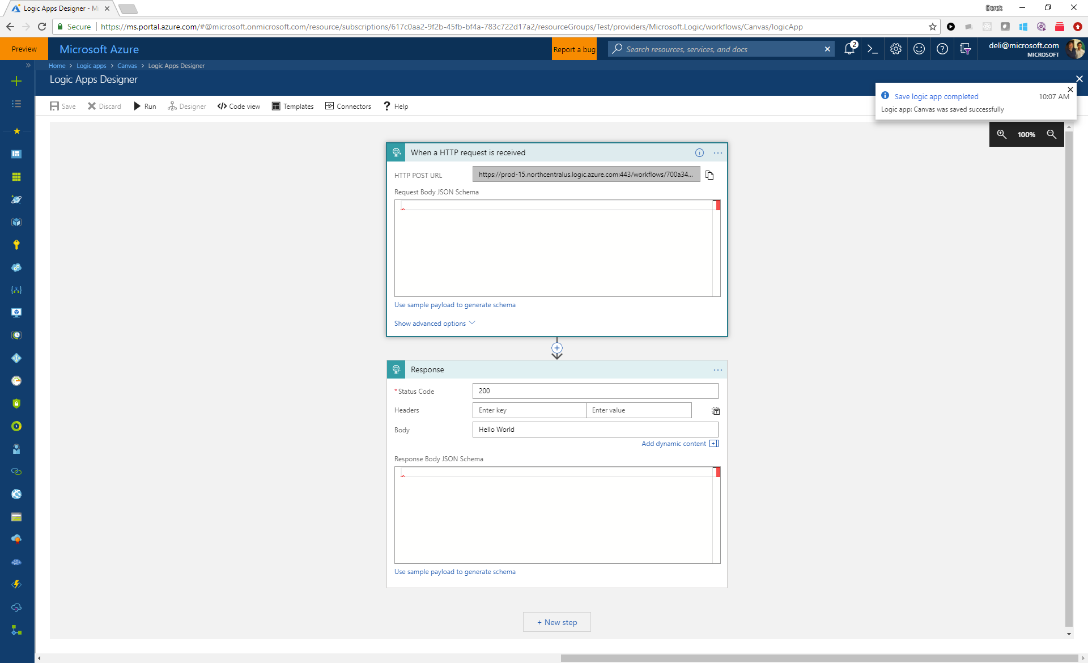

Slide 95
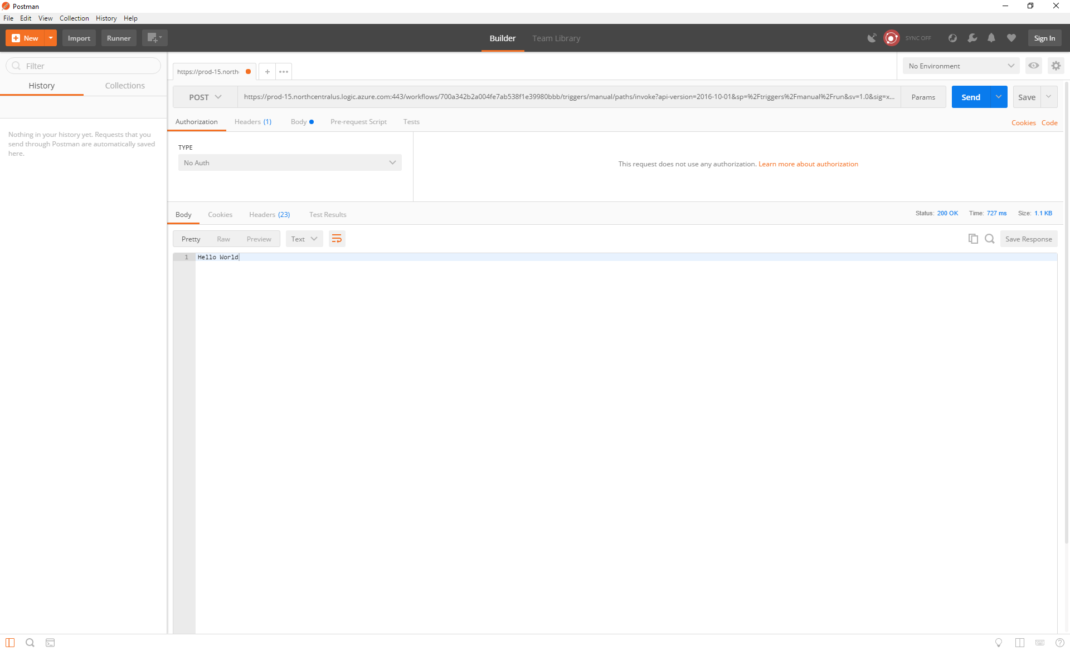

Slide 96
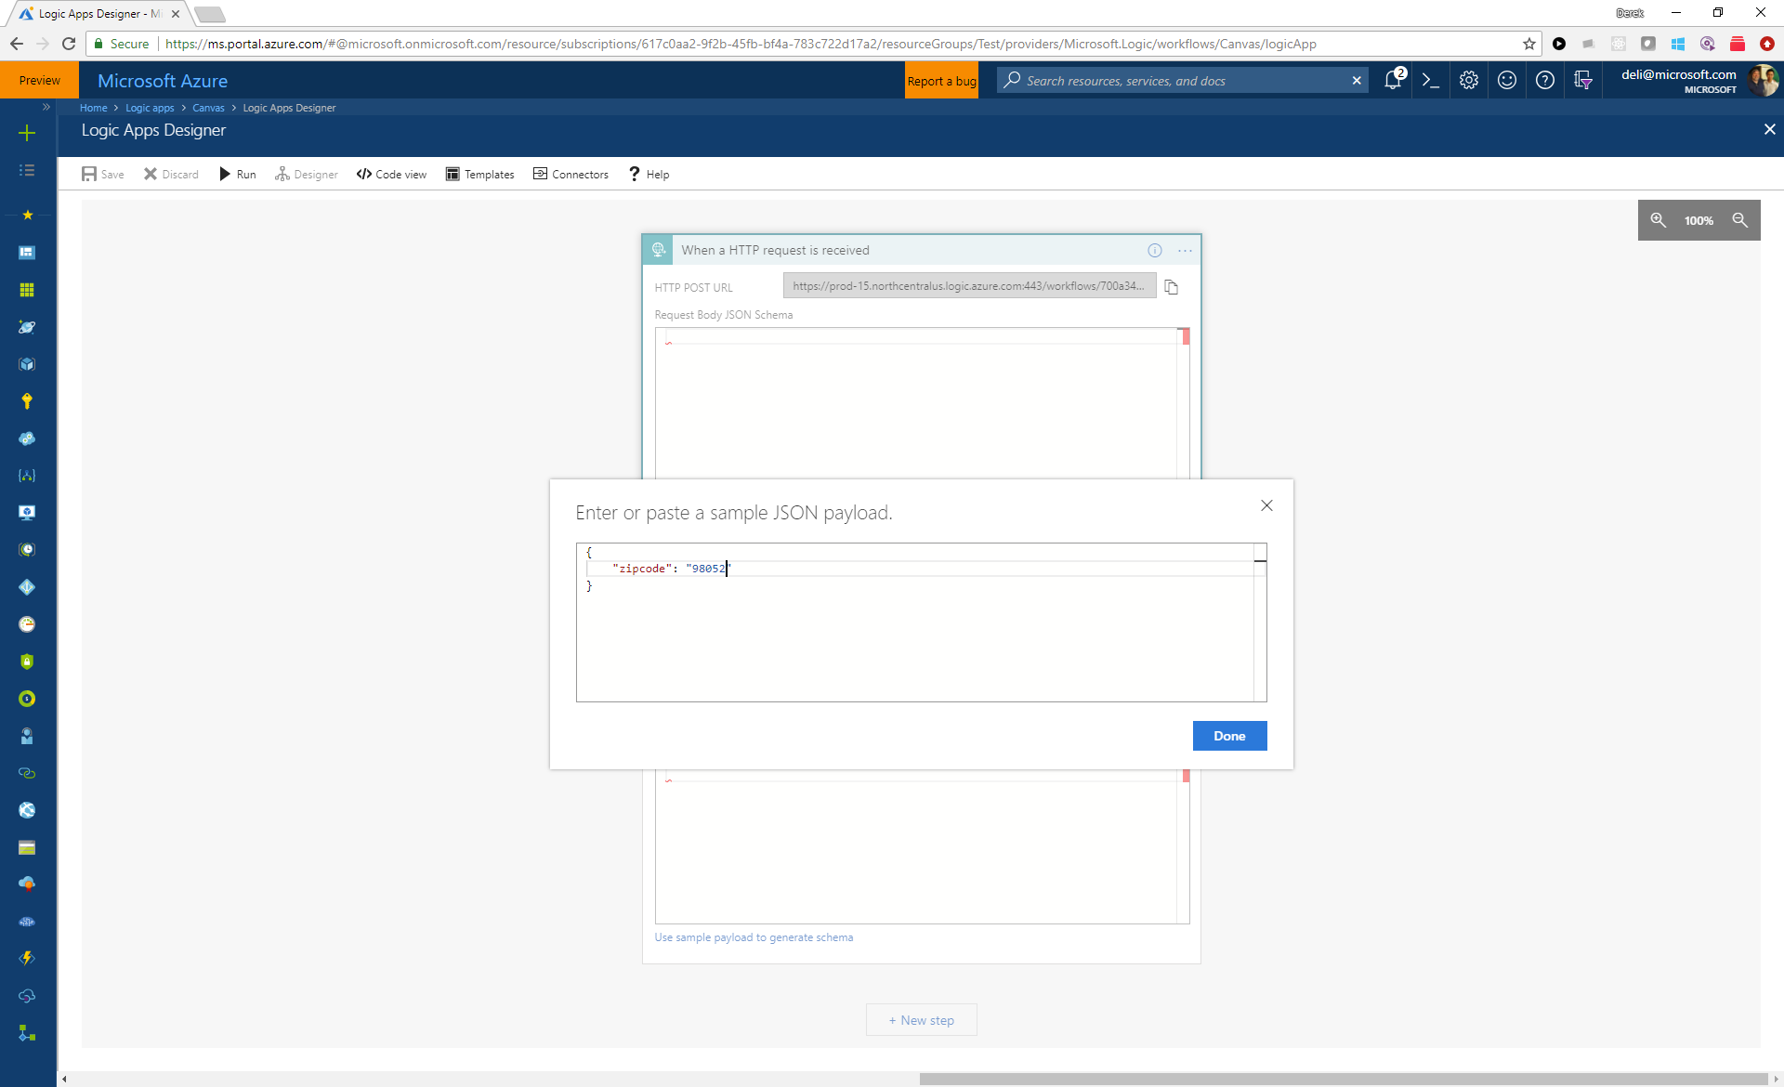

Slide 97
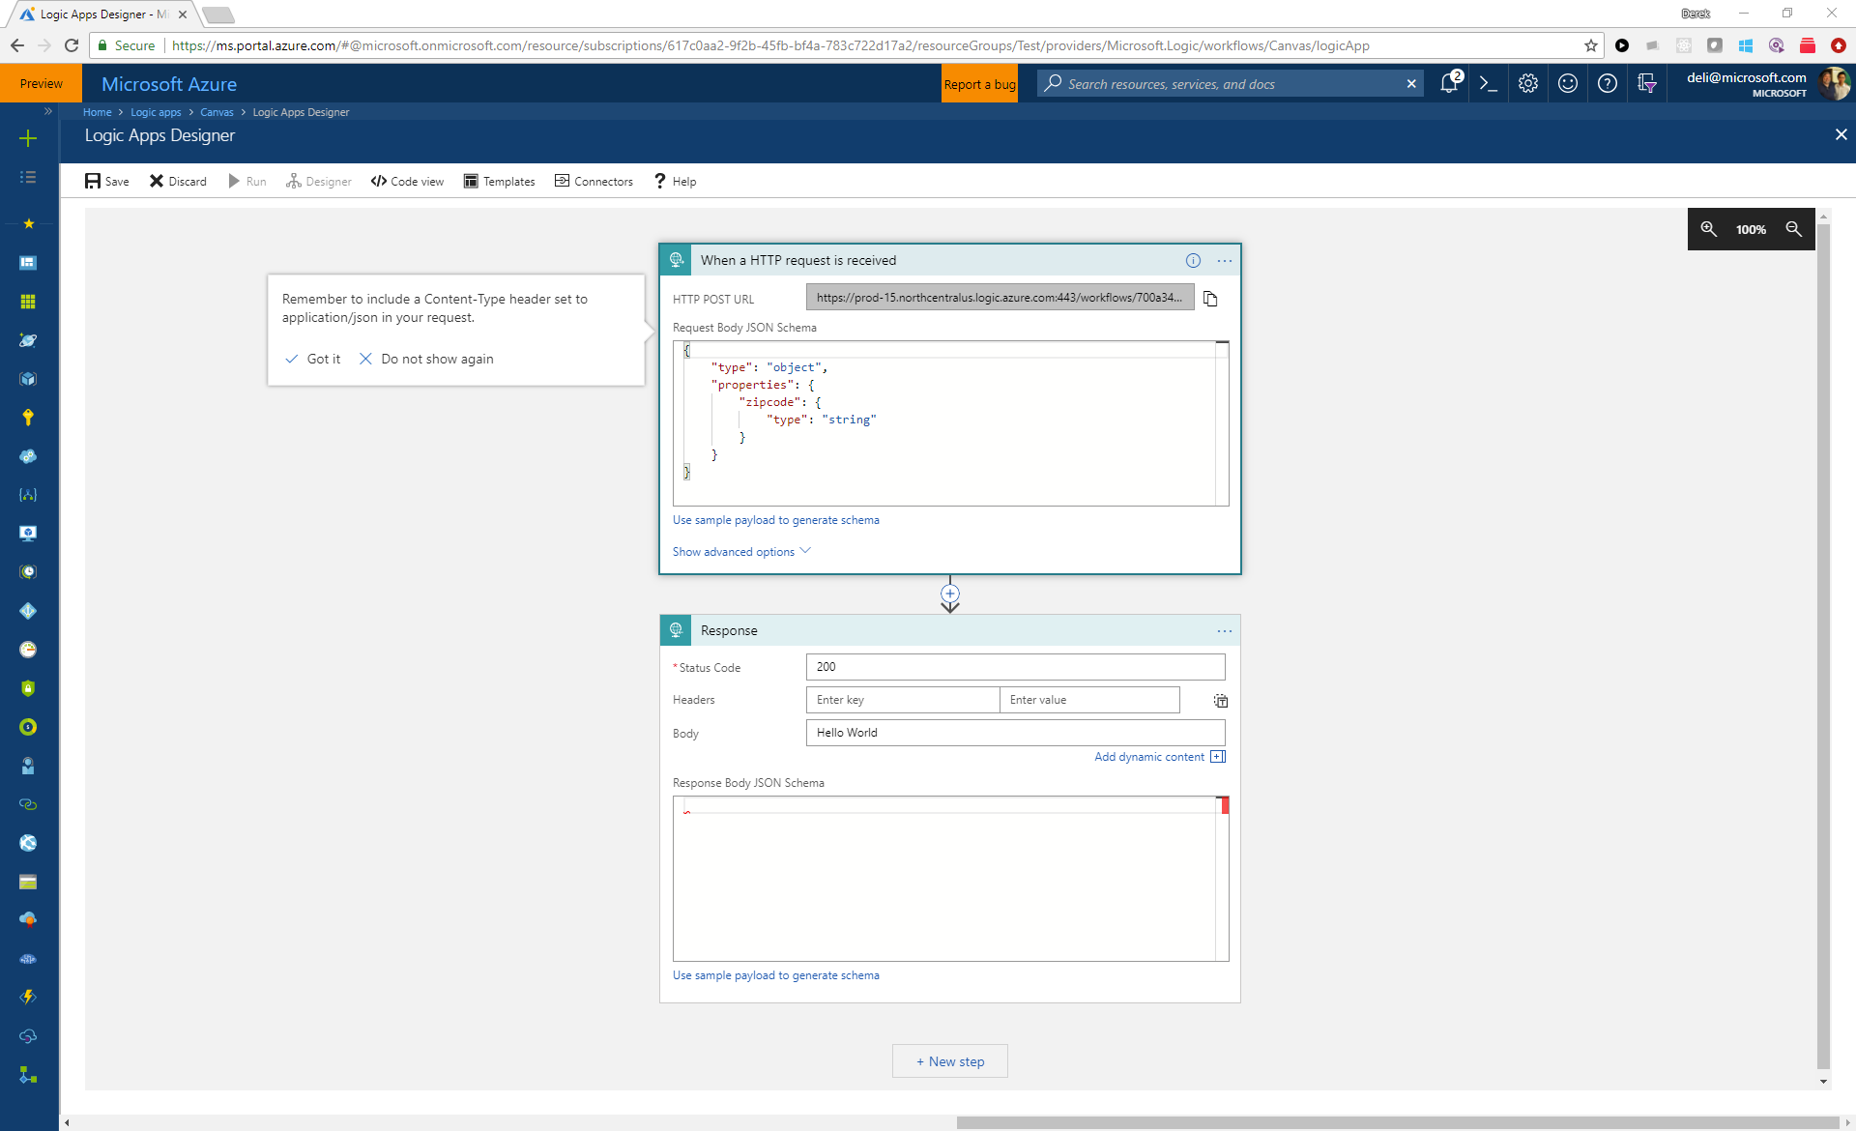

Slide 98
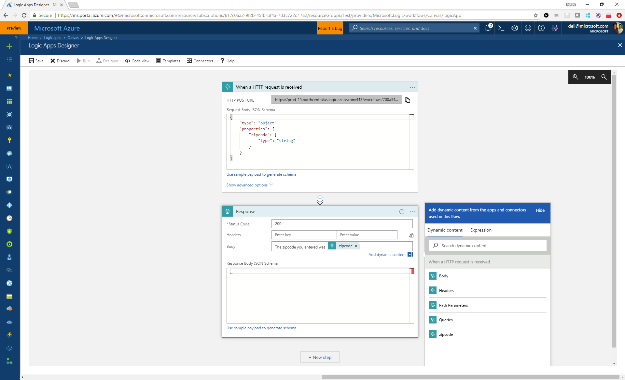

Slide 99
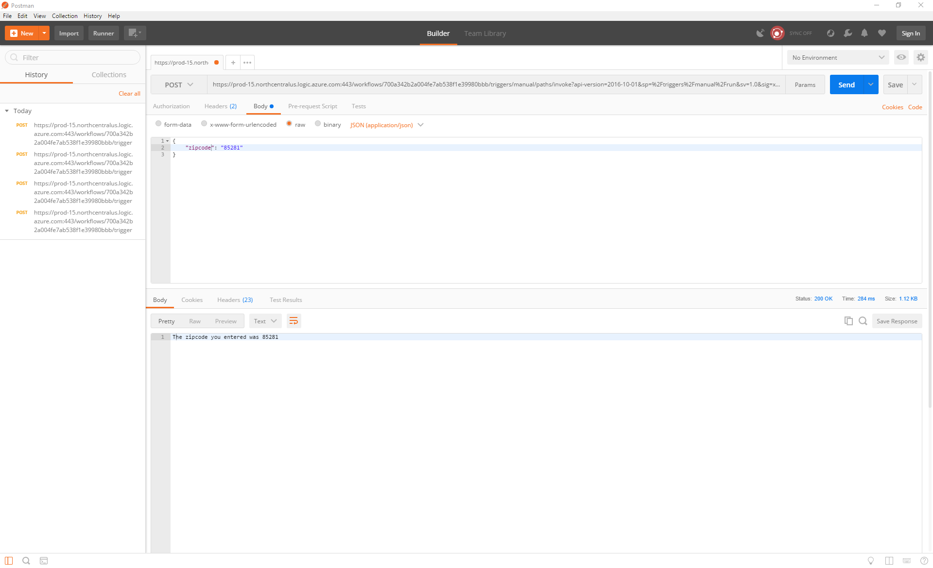

Slide 100
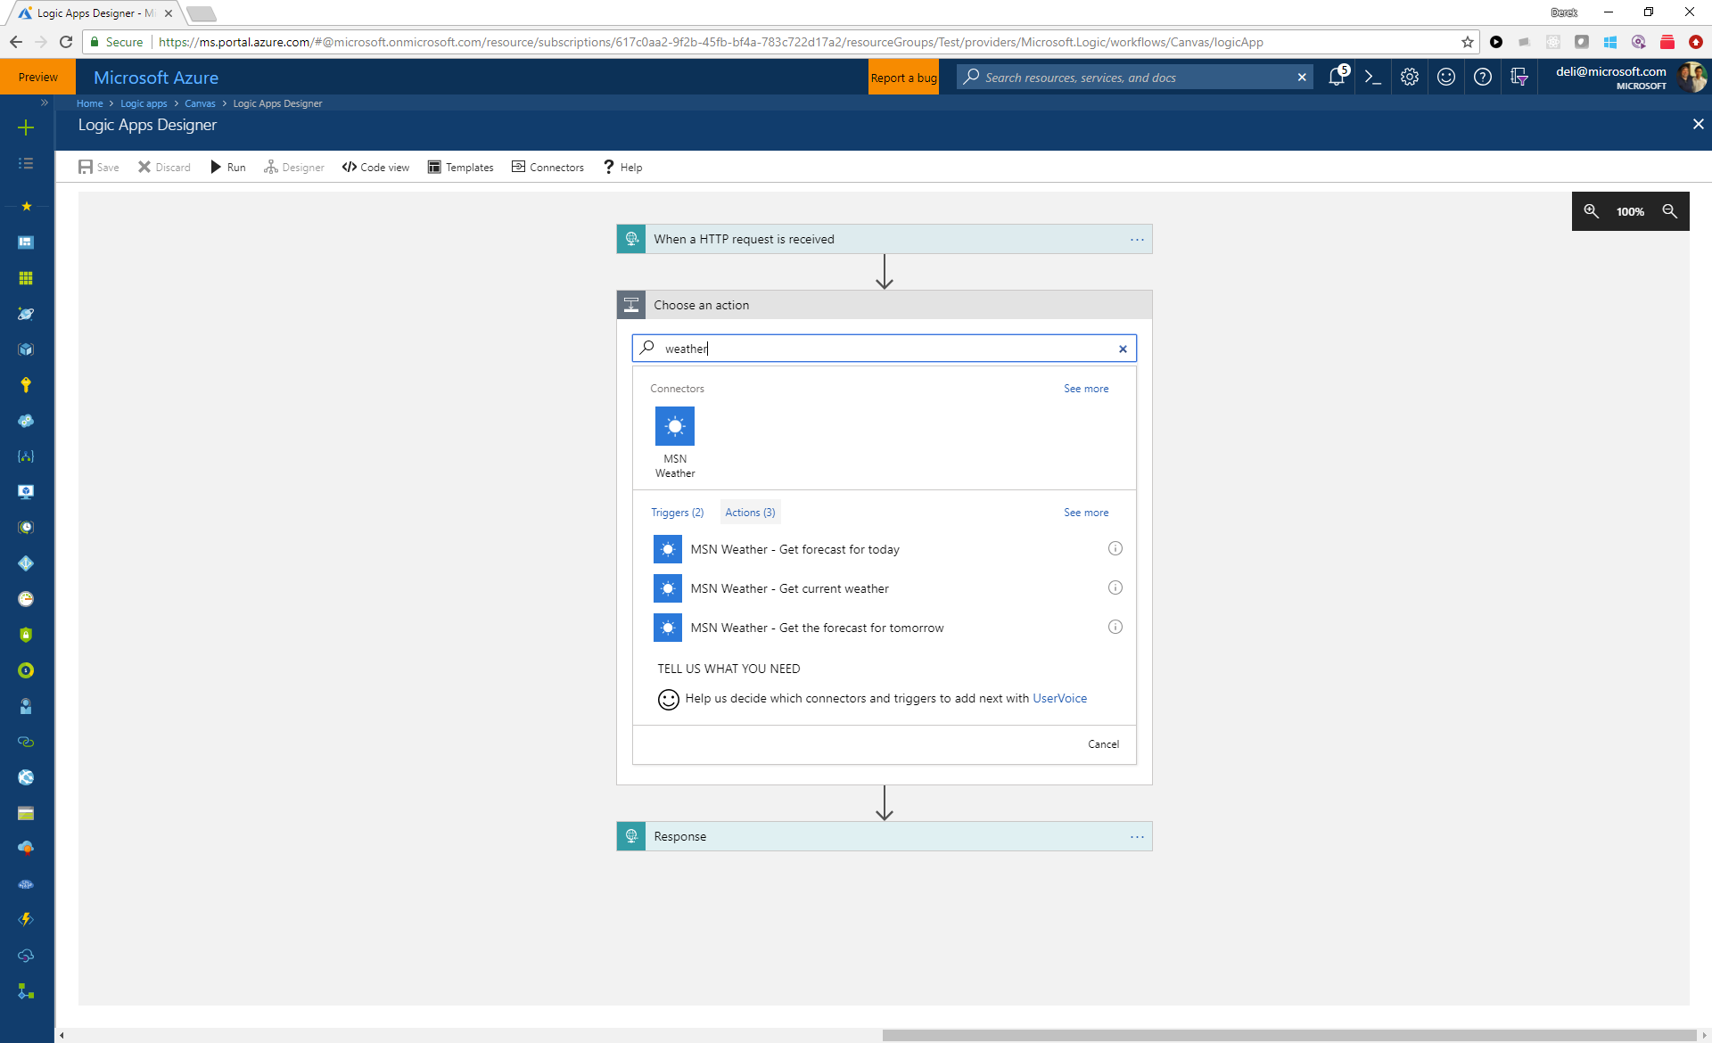

Slide 101
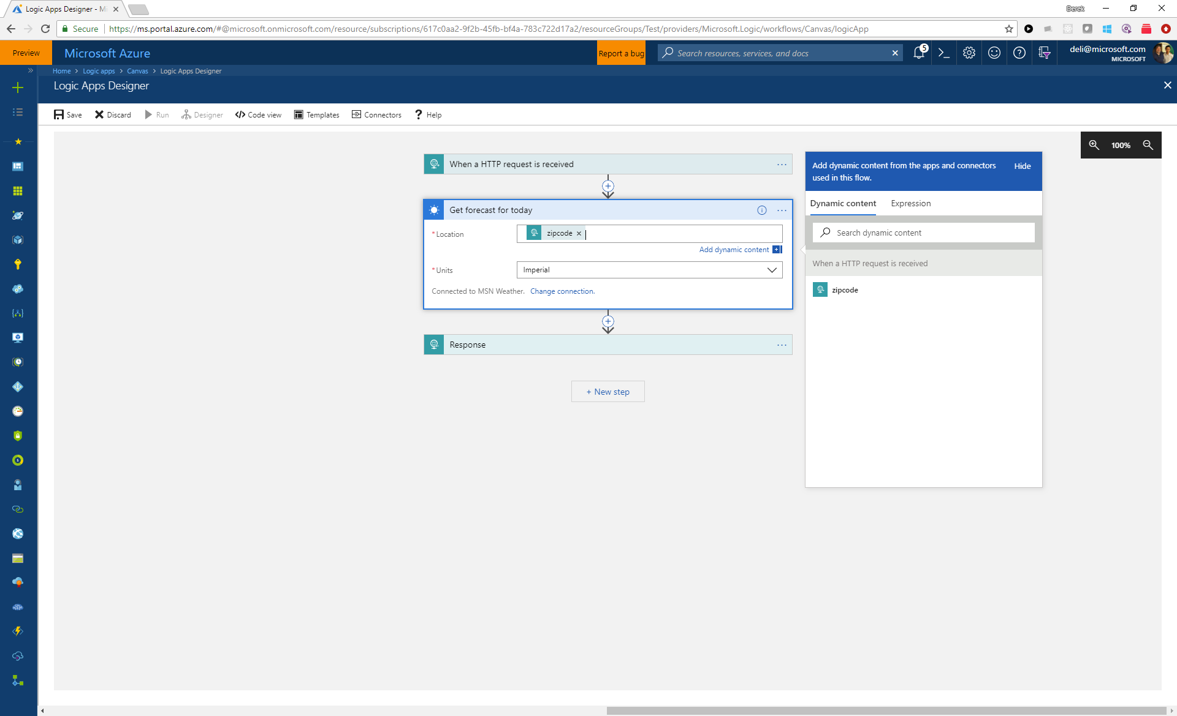

Slide 102
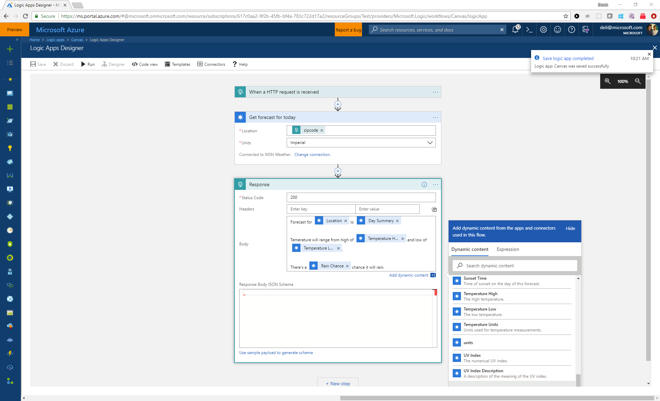

Slide 103
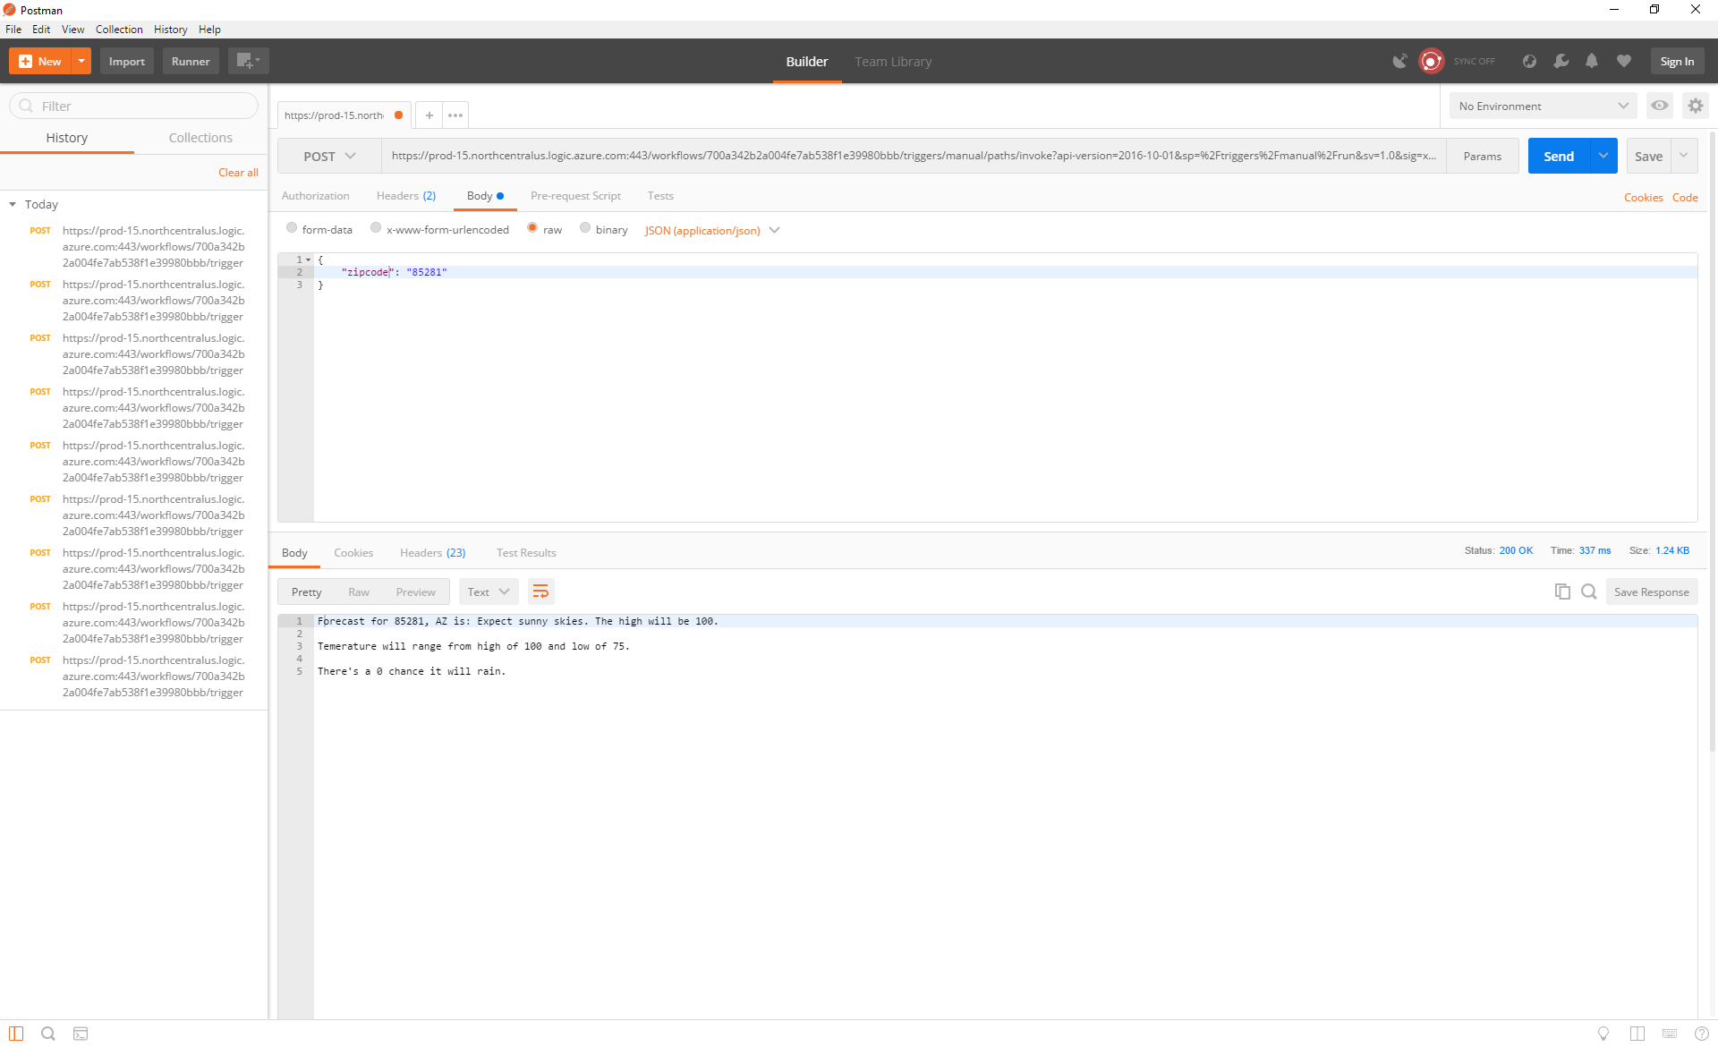

Slide 104
Let’s talk about BFYOC

Slide 105
Customer Satisfaction Survey
Trigger by event from custom topic
Query CosmosDB for product data
Send out e-mail survey
Collect and store in CosmosDB

Slide 106
Module 4 – Orchestrating serverless workflows
Instructions at
https://aka.ms/aac-serverless-workshop

